Slide 1
Outlier Detection for Temporal Data: A Survey
报告人：Jorfun

Slide 2
Outlier Detection for Temporal Data: A Survey
data streams, spatiotemporal data, distributed streams, temporal networks, and time series data
Contribution: Provide a large set of interesting outlier definitions for various forms of temporal data, novel techniques, and application scenarios in which specific definitions and techniques have been widely used.
Temporal outlier analysis examines anomalies in the behavior of the data across time (temporal continuity).
This paper is largely organized by the facet of data type, and examines different
kinds of scenarios along this broad organization.

Slide 3
TIME SERIES (DISCRETE) OUTLIER DETECTION
Outliers in Time Series Databases
Direct Detection of Outlier Time Series
Window based Detection of Outlier Time Series
Outlier Subsequences in a Test Time Series
Outliers Within a Given Time Series
Points as Outliers
Subsequences as Outliers

Slide 4
Direct Detection of Outlier Time Series
Given: A database of time series
Find: All anomalous time series
Unsupervised Discriminative Approaches
Rely on the definition of a similarity function that measures the similarity between two sequences
Once a similarity function is defined, such approaches cluster the sequences, such that within-cluster similarity is maximized, while between-cluster similarity is minimized.
The anomaly score of a test time series sequence is defined as the distance to the centroid (or medoid) of the closest cluster
primary variation: similarity measure + clustering mechanism

Slide 5
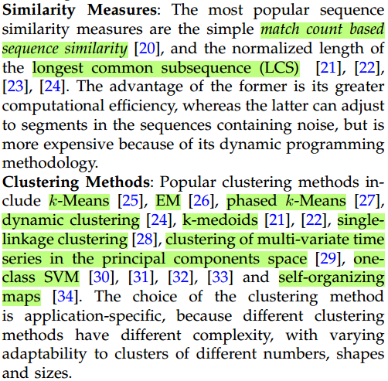
Direct Detection of Outlier Time Series
primary variation: similarity measure + clustering mechanism

Slide 6
Direct Detection of Outlier Time Series
Unsupervised Parametric Approaches
Anomalous instances are not specified, and a summary model is constructed on the base data.
A test sequence is then marked anomalous if the probability of generation of the sequence from the model is very low. The anomaly score for the entire time series is computed in terms of the probability of each element.
Finite state automata (FSA), Markov models and Hidden Markov Models (HMMs)

Slide 7
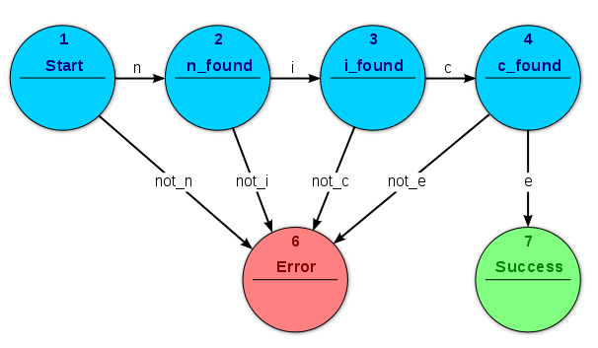
Direct Detection of Outlier Time Series
Unsupervised Parametric Approaches
Finite state automata (FSA)
Training: length l subsequences in normal training data (train FSA model)
Testing: all length l subsequences can be extracted from a test time series and fed into the FSA.
Anomaly criteria: An anomaly is then detected if the FSA reaches a state from where there is no outgoing edge corresponding to the last symbol of the current subsequence

Slide 8
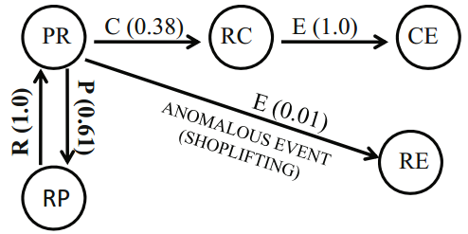
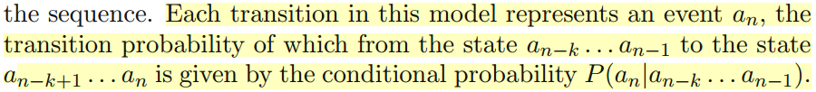
Direct Detection of Outlier Time Series
Unsupervised Parametric Approaches
Markov models
The probability of an edge provides the conditional probability of the corresponding event.

Slide 9
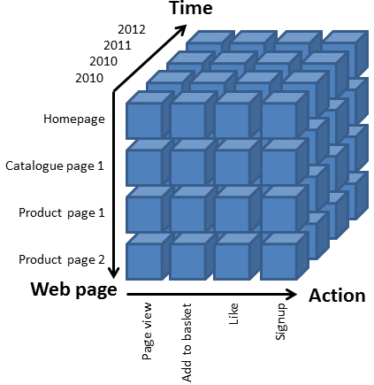
Direct Detection of Outlier Time Series
Unsupervised OLAP based Approach
A time series database may contain a set of time series, each of which are associated with multi-dimensional attributes.
The database can be represented using an OLAP cube, where the time series could be associated with each cell as a measure

Slide 10
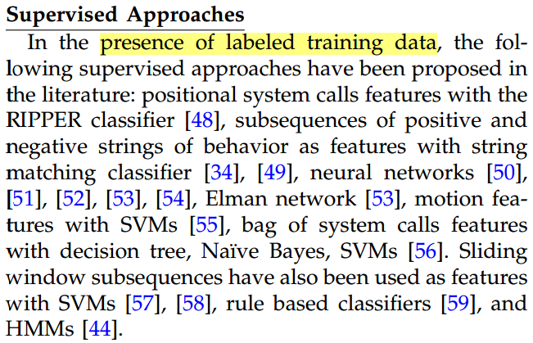
Direct Detection of Outlier Time Series
Supervised Approaches

Slide 11
TIME SERIES (DISCRETE) OUTLIER DETECTION
Outliers in Time Series Databases
Direct Detection of Outlier Time Series
Window based Detection of Outlier Time Series
Outlier Subsequences in a Test Time Series
Outliers Within a Given Time Series
Points as Outliers
Subsequences as Outliers

Slide 12
Window based Detection of Outlier Time Series
Given: A database of time series
Find: All anomalous time windows, and hence anomalous time series
The test sequence is broken into multiple overlapping subsequences (windows). The anomaly score is computed for each window, and then the anomaly score (AS) for the entire test sequence is computed in terms of that of the individual windows.
Better localization of anomalies, compared to the techniques that output the entire time series as outliers directly

Slide 13
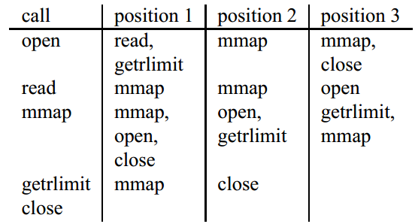
Window based Detection of Outlier Time Series
Normal Pattern Database Approach
Normal sequences are divided into size w overlapping windows. Each such window subsequence is stored in a database with its frequency. For a test sequence, subsequences of size w are obtained, and those subsequences that do not occur in normal database are considered mismatches. If a test sequence has a large number of mismatches, it is marked as an anomaly.
lookahead based method

Slide 14
Window based Detection of Outlier Time Series
Negative and Mixed Pattern Database Approaches
Besides the dictionaries for normal sequences, anomaly dictionaries can also be created.
Detectors can be generated randomly or by using some domain knowledge of situations that are not expected to occur in normal sequences.
A test sequence is then monitored for presence of any detector. If any detector matches, the sequence can be considered an outlier.

Slide 15
TIME SERIES (DISCRETE) OUTLIER DETECTION
Outliers in Time Series Databases
Direct Detection of Outlier Time Series
Window based Detection of Outlier Time Series
Outlier Subsequences in a Test Time Series
Outliers Within a Given Time Series
Points as Outliers
Subsequences as Outliers

Slide 16
Outlier Subsequences in a Test Time Series
Series
Given: A database of time series D and a test time series t
Find: An outlier subsequence (or a pattern) p in t
The anomaly score for a pattern p can be computed as the difference between the frequency of pattern p in test time series and the expected frequency in database D.
soft match(本文提供了两种方法)
To make the computations efficient: TARZAN algorithm, Interpolated Markov Models (IMM)

Slide 17
TIME SERIES (DISCRETE) OUTLIER DETECTION
Outliers in Time Series Databases
Direct Detection of Outlier Time Series
Window based Detection of Outlier Time Series
Outlier Subsequences in a Test Time Series
Outliers Within a Given Time Series
Points as Outliers
Subsequences as Outliers

Slide 18
Points as Outliers
Given: A time series t
Find: Outlier points in t
Prediction Models
The outlier score for a point in the time series is computed as its deviation from the predicted value by a summary prediction model.
The primary variation across models, is in terms of the particular prediction model used.

Slide 19
Points as Outliers
Profile Similarity based Approaches
Maintain a normal profile and then compare a new time point against this profile to decide whether it is an outlier.
Tiresias system (continuous?)
Maintains a normal profile and also a variance vector.
Any new data point is compared both with the normal profile and the variance vector to compute its anomaly score.
Here the profile is the actual smoothed time series data from past data.
Neural network

Slide 20
Points as Outliers
Deviants
Deviants are outlier points in time series from a minimum description length (MDL) point of view [88]. If the removal of a point P from the time sequence results in a sequence that can be represented significantly more succinctly than the original one, then the point P is a deviant.
These information theoretic models explore the space-deviation tradeoff by fixing the deviation, rather than fixing the space, as in conventional models.
dynamic programming mechanism and its approximation solution

Slide 21
TIME SERIES (DISCRETE) OUTLIER DETECTION
Outliers in Time Series Databases
Direct Detection of Outlier Time Series
Window based Detection of Outlier Time Series
Outlier Subsequences in a Test Time Series
Outliers Within a Given Time Series
Points as Outliers
Subsequences as Outliers

Slide 22
Subsequences as Outliers
Given: A time series t
Find: Outlier subsequences in t
Given a time series T , the subsequence D of length n beginning at position l is said to be the discord (or outlier) of T if D has the largest distance to its nearest non-overlapping match.
Subsequence comparisons can be smartly ordered for effective pruning using various methods.
Methods to compute the distance between subsequences.
Other definitions of subsequence outlier detection problem.

Slide 23
感谢聆听

